Slide 1


Entrepreneurial Activities in SSH Disciplines
AESIS Course – Innovation and Entrepreneurship for PHDs and Post-Docs
Online, 14 May 2021
Oliver.cox@humanities.ox.ac.uk
Twitter: @OliverJWCox

Slide 2
Aims of this afternoon’s session:
Share personal experiences of developing an entrepreneurial portfolio;
Explore drivers and barriers to entrepreneurship and the role of consultancy as a variant of entrepreneurship in an academic career;
Suggest sectors and areas of interest for Consultancy in SSH.
How to develop an institutional culture around entrepreneurship;
What structures can be put in place to enable and facilitate entrepreneurial thinking at an institutional level;
What this looks like from an end user’s perspective.

Slide 3
Session Timetable:
14:15 | Aims of the Session and Session Timetable
14:20 | Introduction – What does a Heritage Engagement Fellow do all day?
14:30 | Group Introductions – What do you do all day?
14:40 | Why did I do it? Personal Experiences of Entrepreneurship
14:55 | Workshop 1: Mapping the Barriers to Entrepreneurship
15:05 | Overcoming Obstacles and Creating an Entrepreneurial Mindset
15:10 | The Hacker and the Thief: Lessons from the Session
15:15 | Session Ends

Slide 4
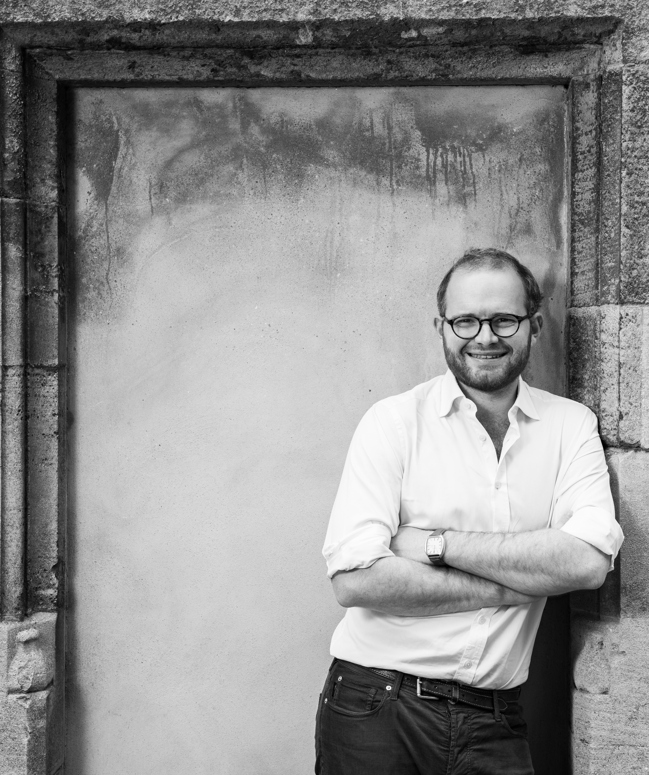
Introduction: What does a Heritage Engagement Fellow do all day?
Heritage Engagement Fellow at the University of Oxford, leading the TORCH Heritage Programme.
Co-Director of Oxford University Heritage Network.
Oxford University Innovation Champion for Humanities Division.
Part of team delivering University’s strategic partnership with the National Trust.
Industry Champion, NESTA-AHRC Creative Industries Policy and Evidence Centre.
Eighteenth-century historian by training, completed D.Phil in 2013.
Consultancy work an extension of initial post as Knowledge Exchange Fellow.

Slide 5
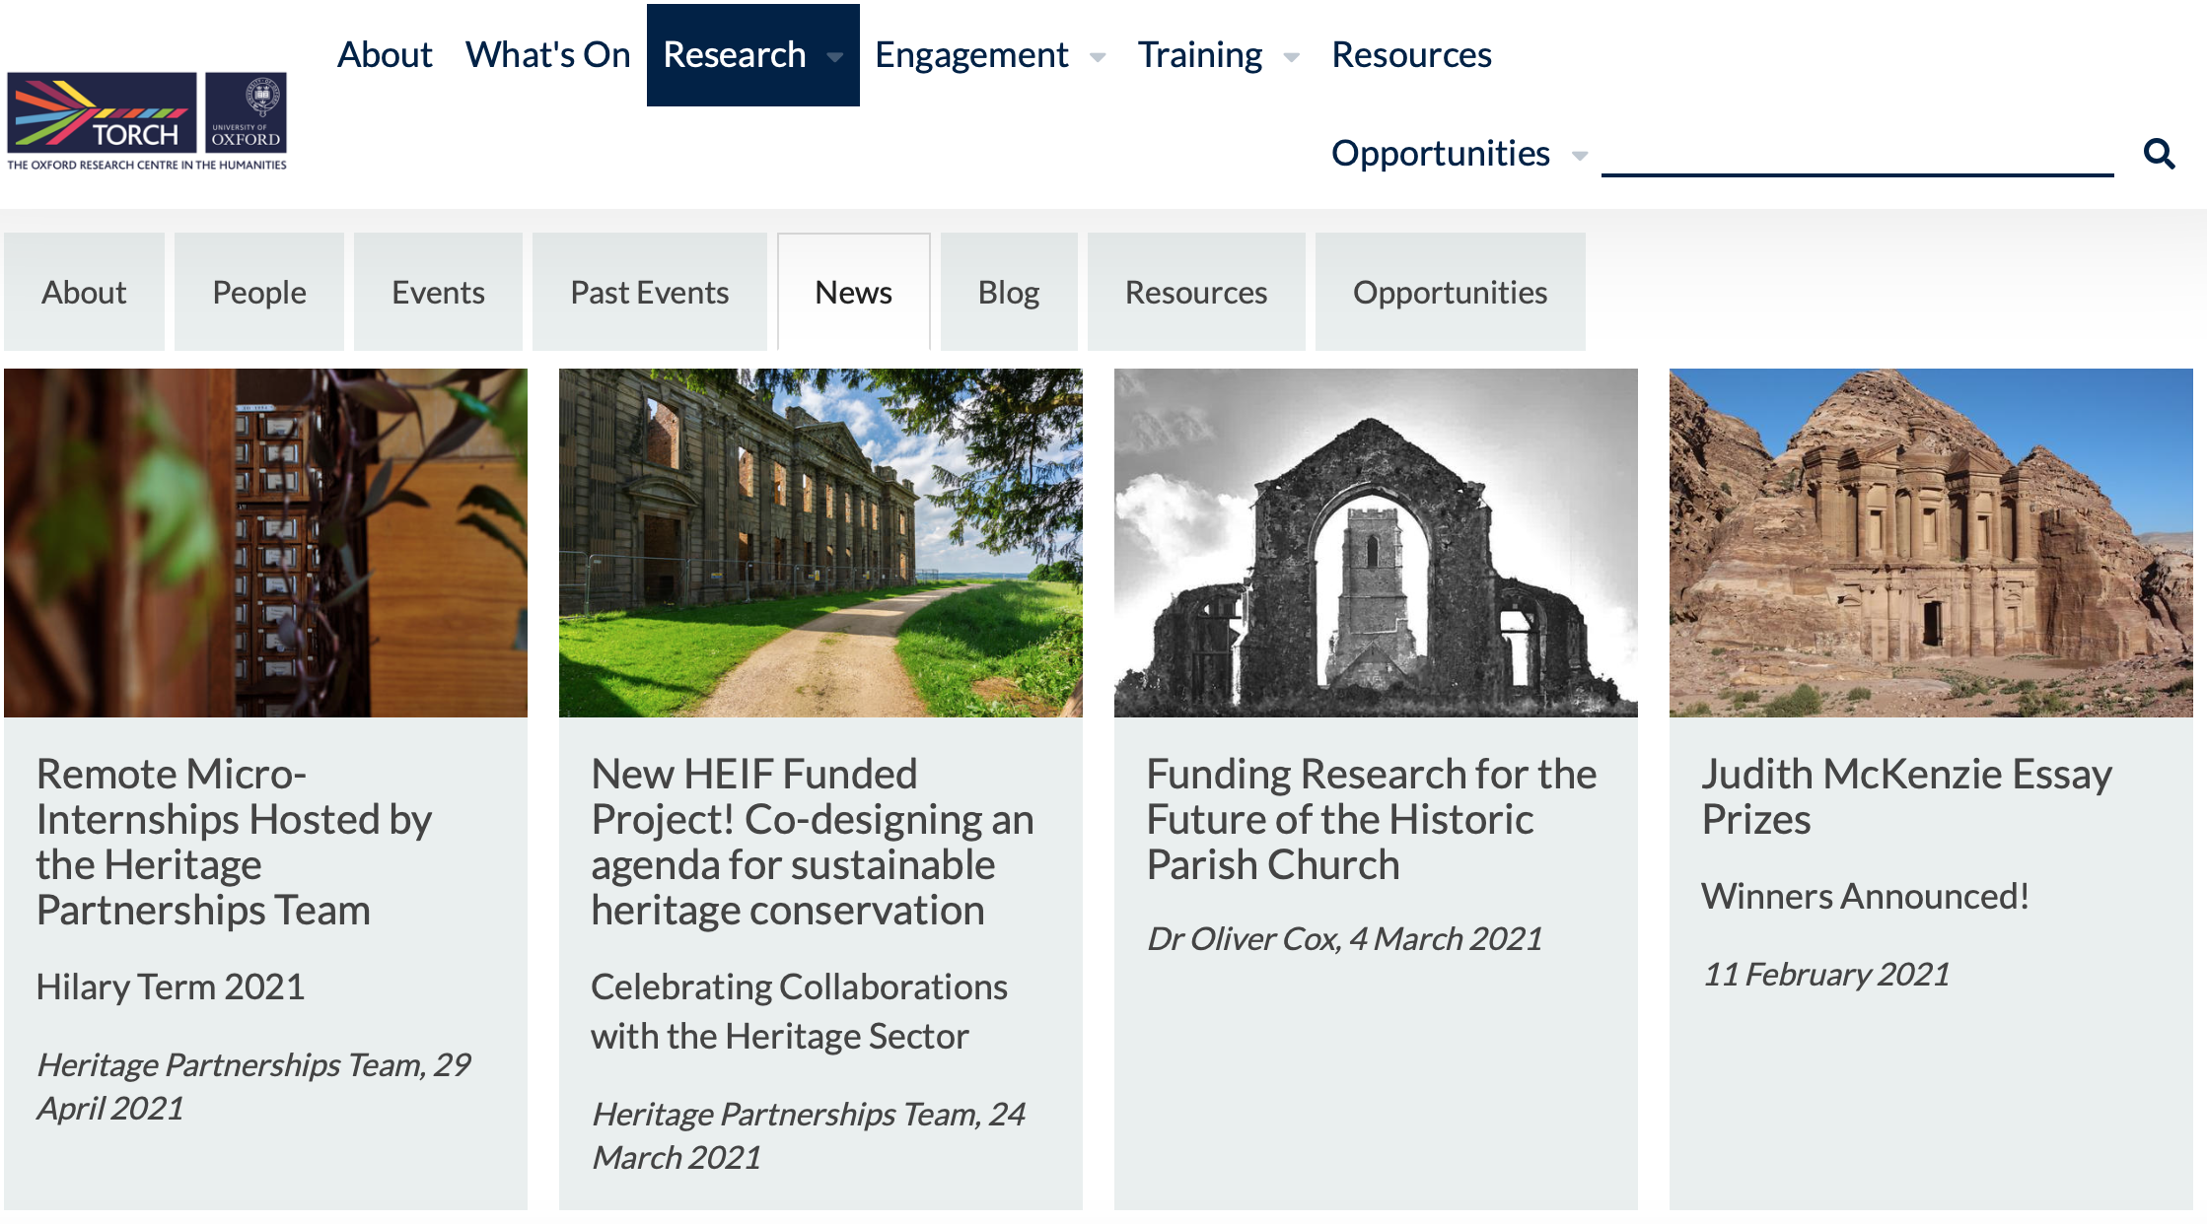

Slide 6
Heritage Partnerships Team
Our Values
Open Collaborative Inventive
Our Vision
‘To enable ambitious and mutually beneficial partnerships that connect Oxford’s world- leading expertise with the UK and International Heritage Sector’
Our Pillars
Building Partnerships
Growing Expertise
Sharing Knowledge
Our Foundations
A growing network of students, researchers, support and professional staff at the University of Oxford interested in working with the UK and International Heritage Sector, encouraged by the Oxford University Heritage Network.

Slide 7


Slide 8


Slide 9
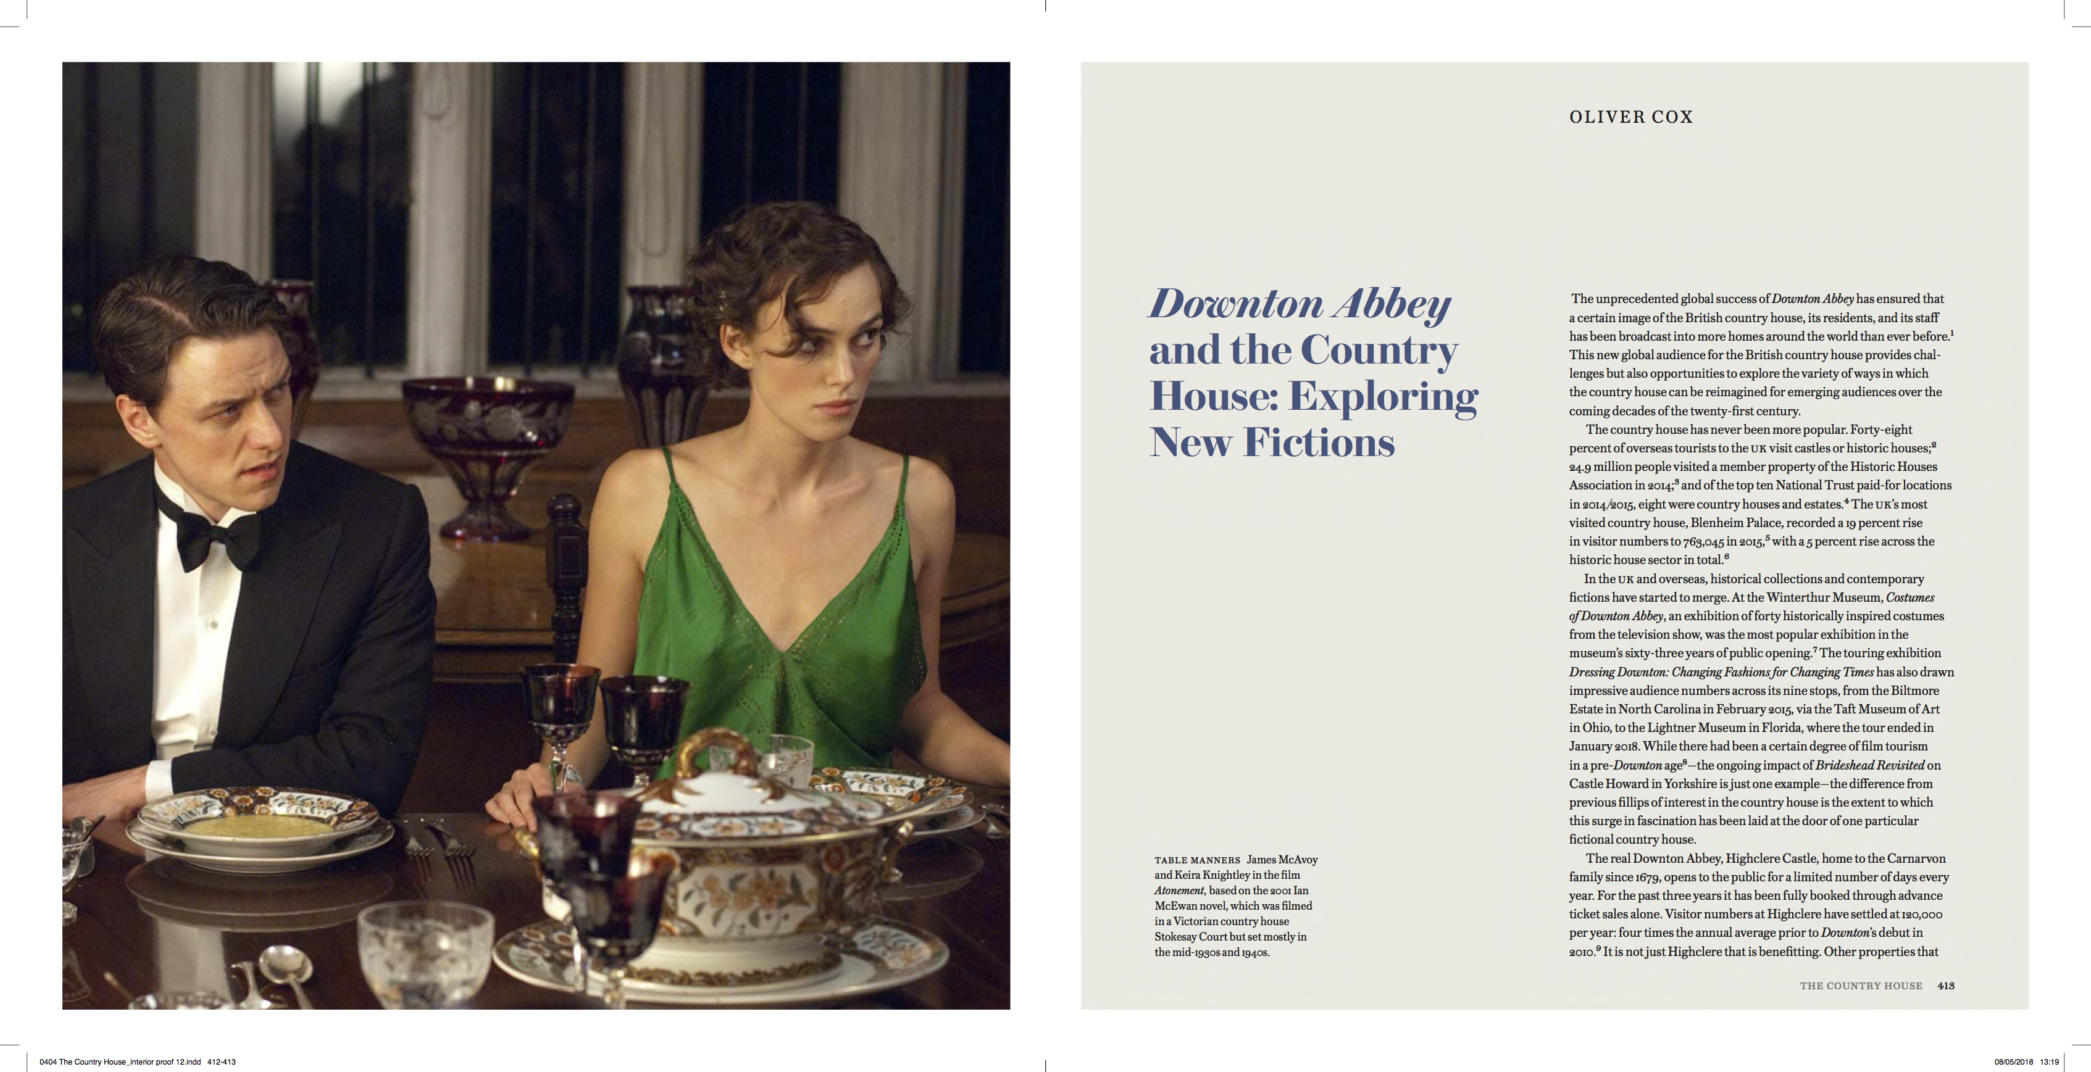
My Areas of Research Interest
Current Research Activity includes:
  The future of the country house, and the history of country house studies.
  ’Jewish’ Country Houses – Objects, Networks, People.
  Horse racing and society in the British Empire from the early eighteenth-century to the present day.
  Interpreting and understanding the eighteenth-century in the twenty-first century.
Current PhD students’ research topics:
  National Heritage in Private Hands: The Political and Cultural Role of Independently-Owned Country Houses in Britain after World War Two.
  "We mould it according to our own lights": The Interpretation of the British Country House for the Visiting Public from the Mid-20th Century to the Present Day
  Horseracing and the Victorian Aristocracy

Slide 10
Who are you?

Slide 11
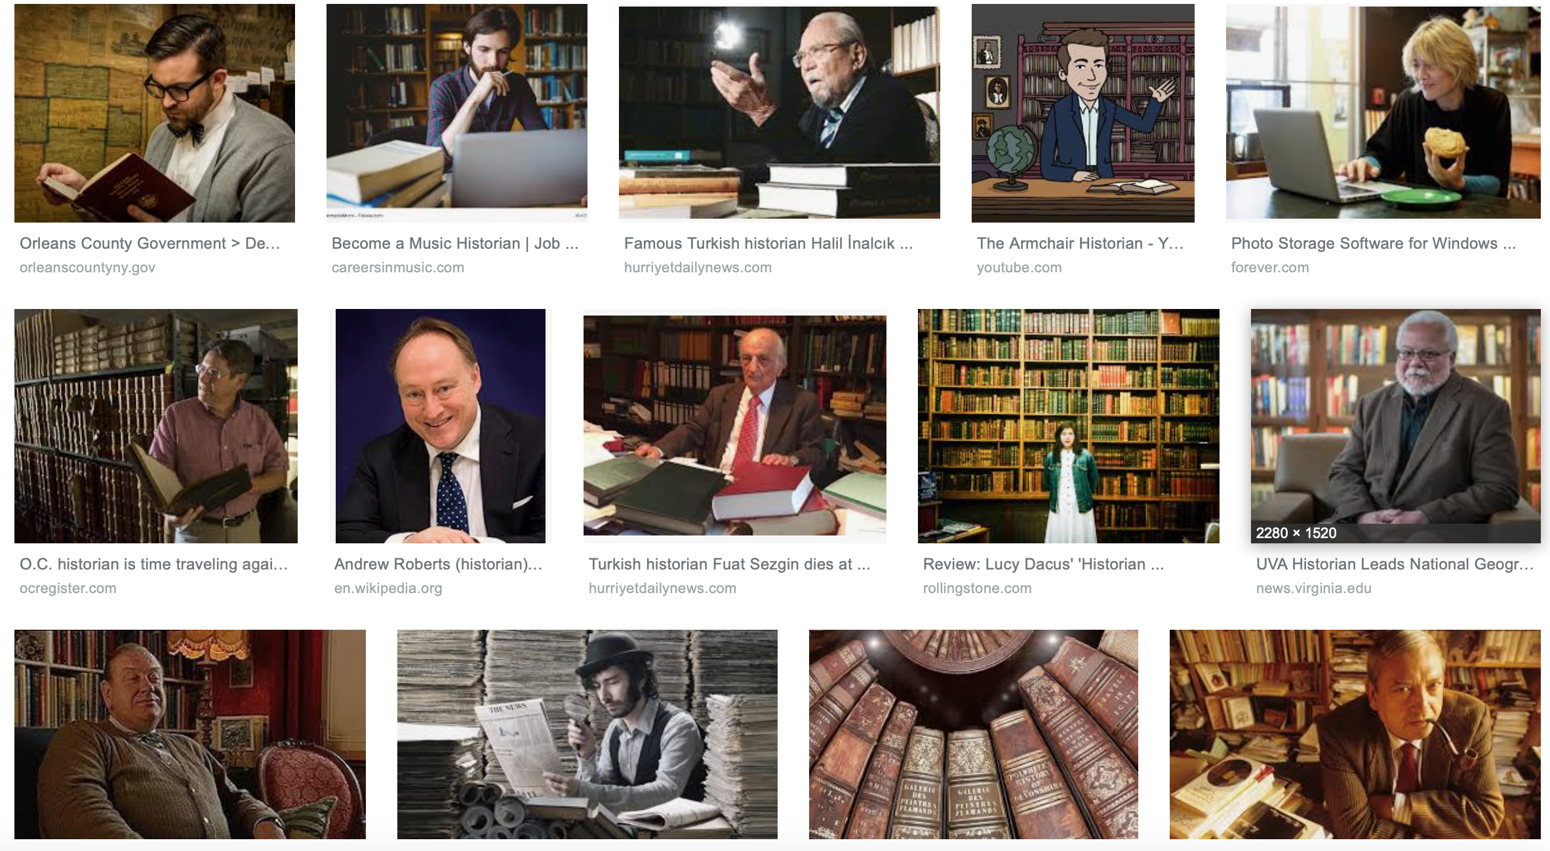
Why did I do it? Personal Experiences of Entrepreneurship
Address the image problem that historians have.

Slide 12
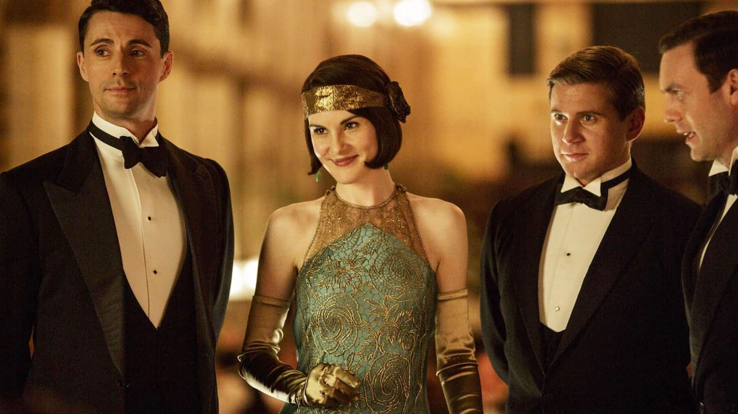
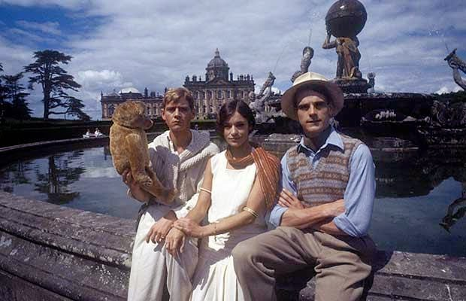
Address the image problem that historians of the country house have.

Slide 13
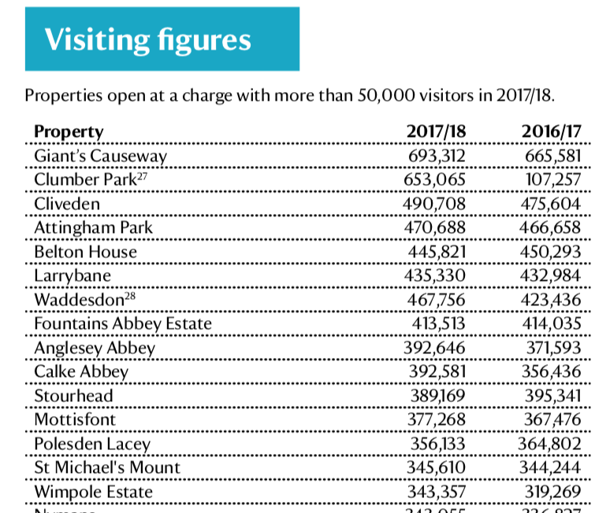
Share stories with a wider audience and find new routes to market.
New Research
New Stories
New Partnerships
New Audiences

Slide 14

Creating Triple A Content

Slide 15
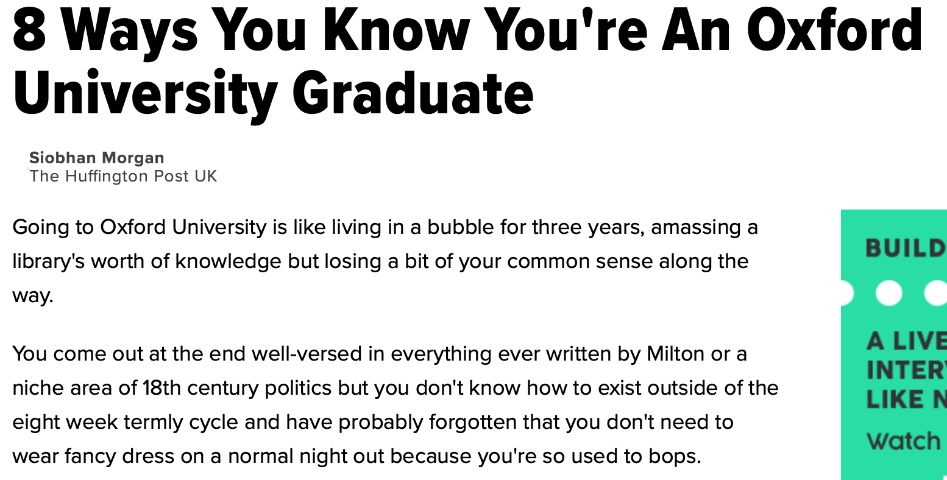
Breaking Free from the Academic Bubble and the Academic Mindset.

Slide 16
6. Create a distinctive and marketable identity.
Inventiveness
Credibility
Knowledge

Slide 17
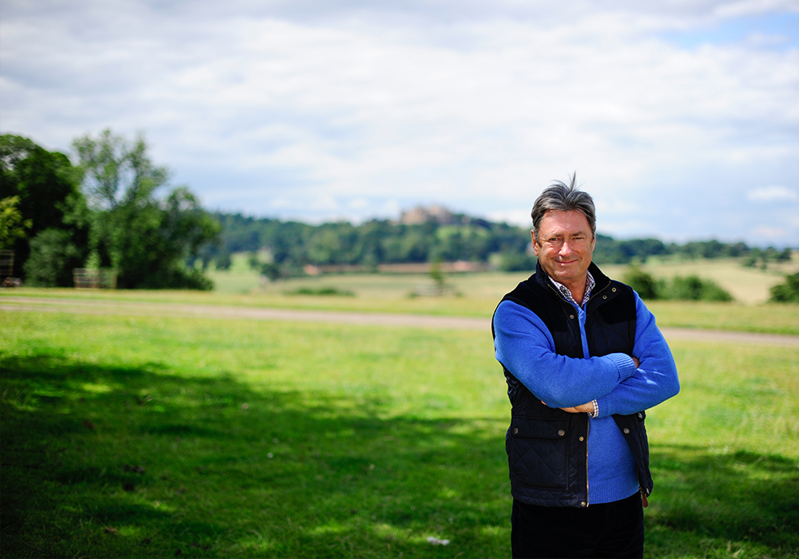

Example Projects (1): Spun Gold TV
  Expert consultancy for 3 x 60 minute documentary celebrating 300 years since Lancelot ‘Capability’ Brown’s birth for Spun Gold TV.
  Two-days of workshops and meetings with production team.
  One-day of filming with Alan Titchmarsh at Wotton House.
  Sharing of research from D.Phil and research in progress as to contemporary relevance of Capability Brown.
  Opportunity to build public profile and awareness of difference – i.e. one of the very few young historians who can talk knowledgeably about landscape design in the eighteenth century.

Slide 18
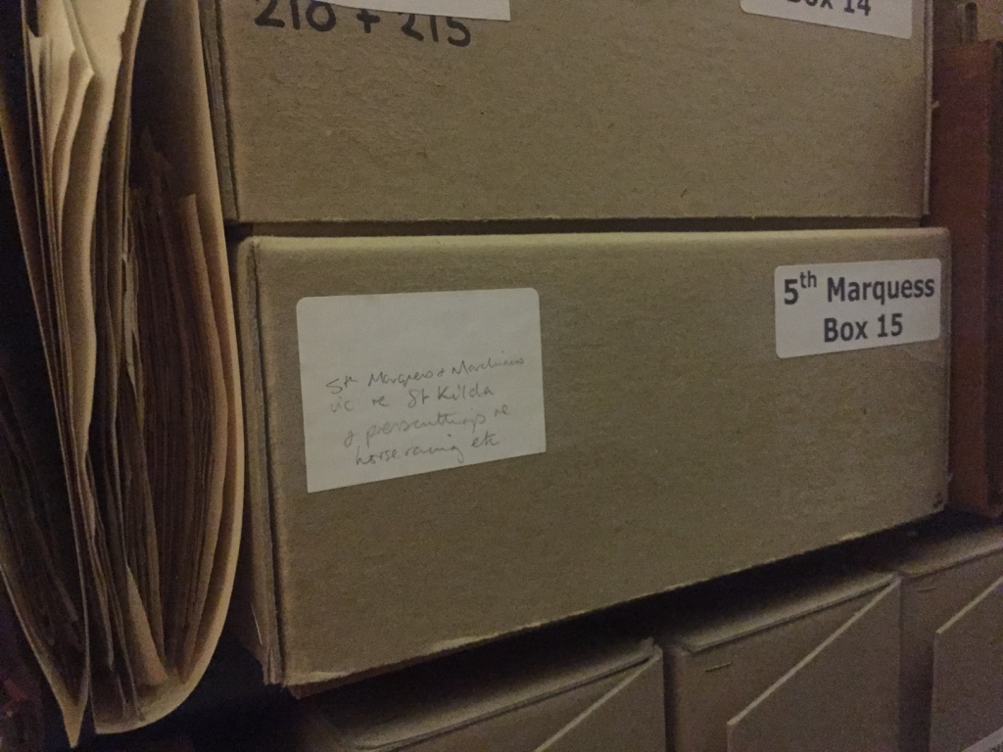
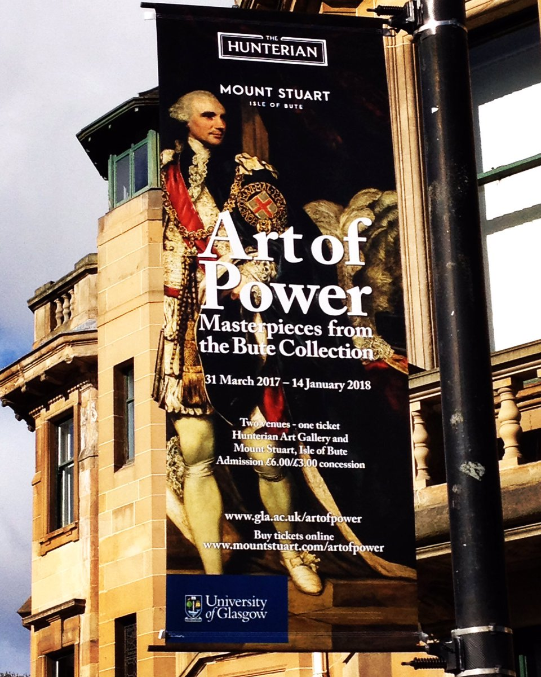
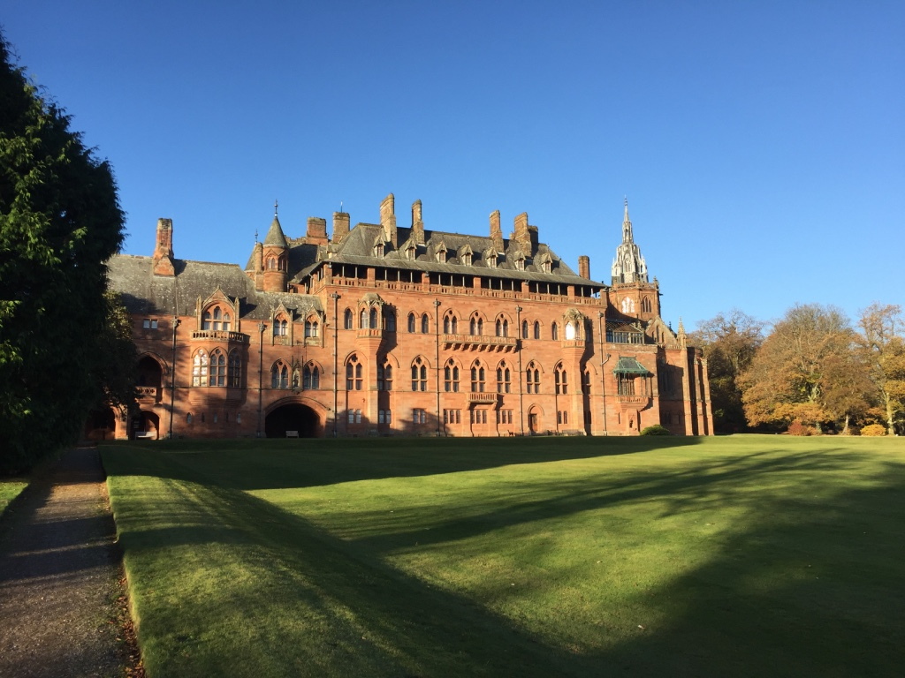
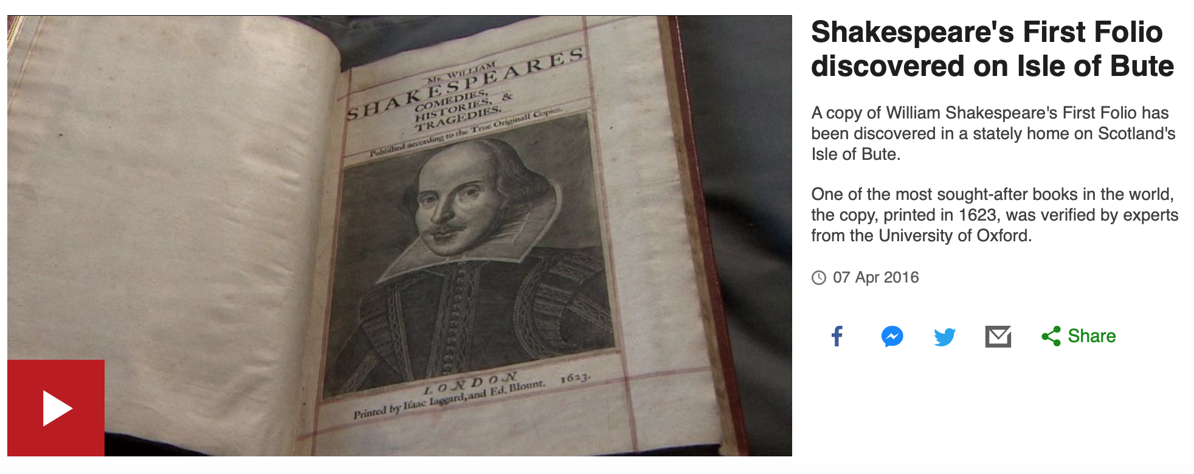
Example Projects (2): Mount Stuart Trust
  3 day per month consultancy for Mount Stuart Trust, Isle of Bute, Scotland (18 month duration).
  Support a charitable trust, and privately-owned collection, to build connections with universities.
  Major public success through discovery of ‘lost’ Shakespeare First Folio.
  Contributed to exhibition, Art of Power: Treasures from the Bute Collection (Hunterian Museum, Glasgow), and peer-reviewed chapter in exhibition catalogue.
  Access to new research resources and material in a previously under-researched archive resulting in peer-reviewed publications.
  Brokered connections with Yale University and Paul Mellon Centre for British Art.

Slide 19
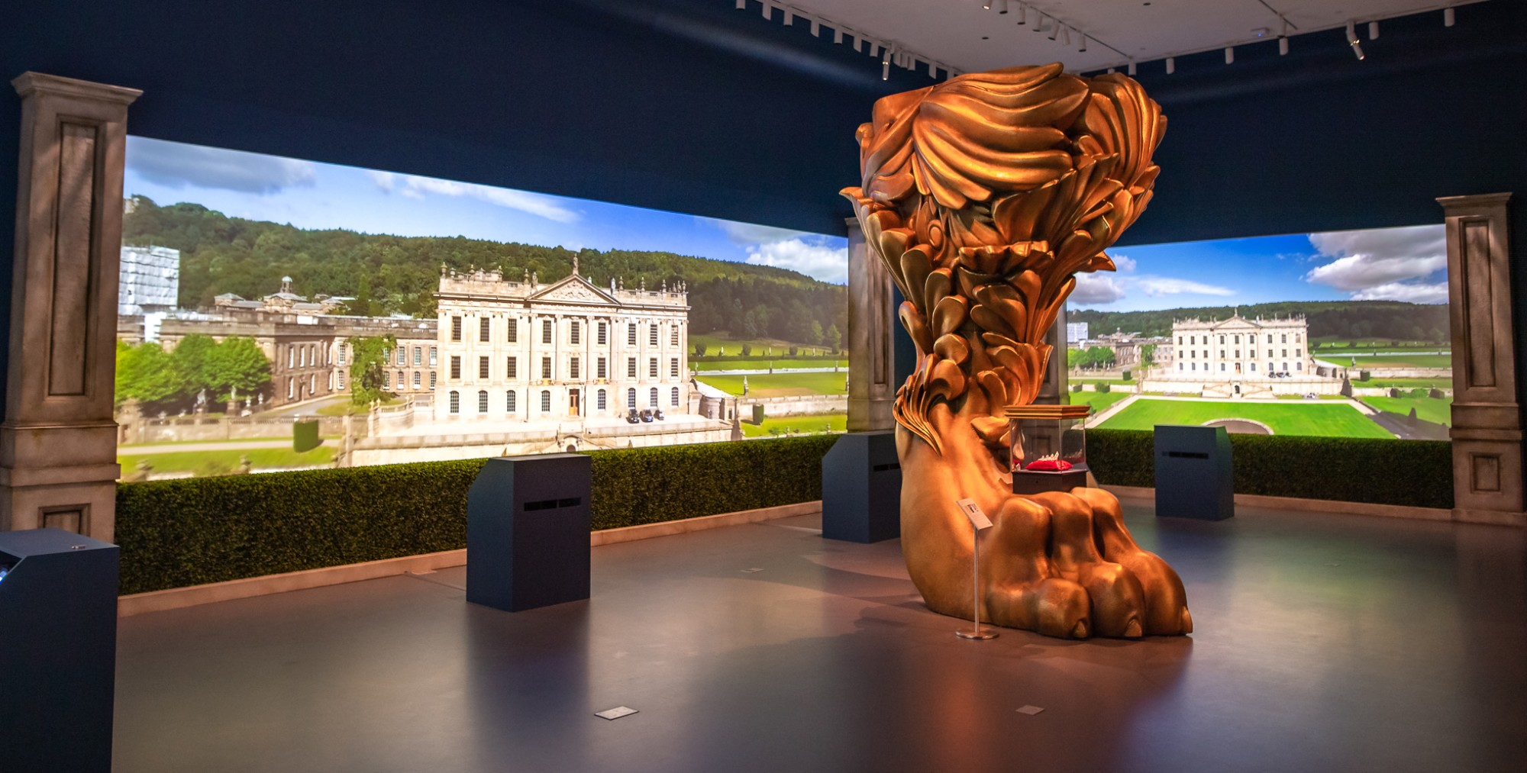
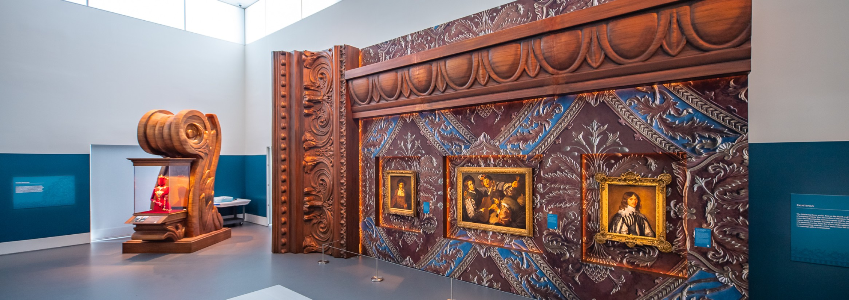
Example Projects (3): Chatsworth House Trust
  5 days of Consultancy for Chatsworth House Trust to support content development and writing for Treasures from Chatsworth Exhibition at Sotheby’s New York.
  Collaborated with exhibition designers (David Korins Studios, New York) via conference calls to ensure coherent narrative and object placement to support the key messages for Chatsworth House Trust.
  Brokered introductions for CHT’s Head of Development with speakers for associated talks and private view programme in New York.

Slide 20
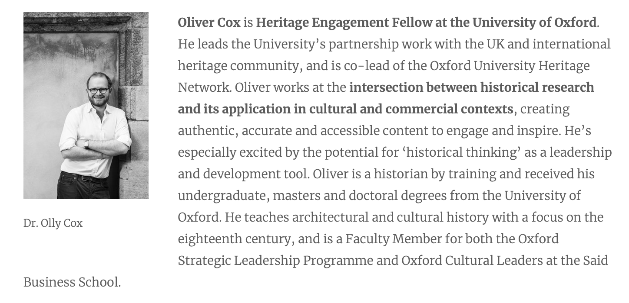
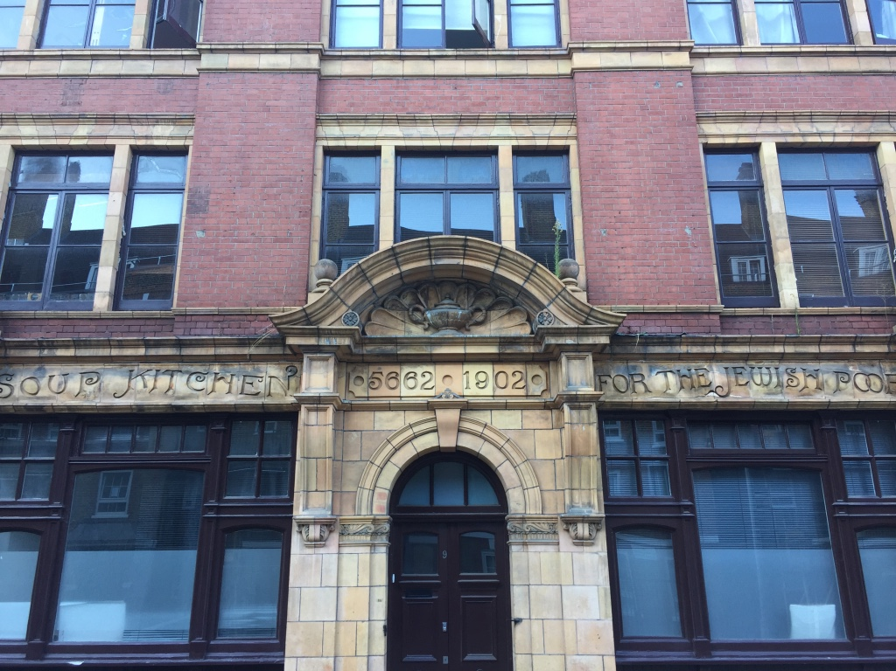
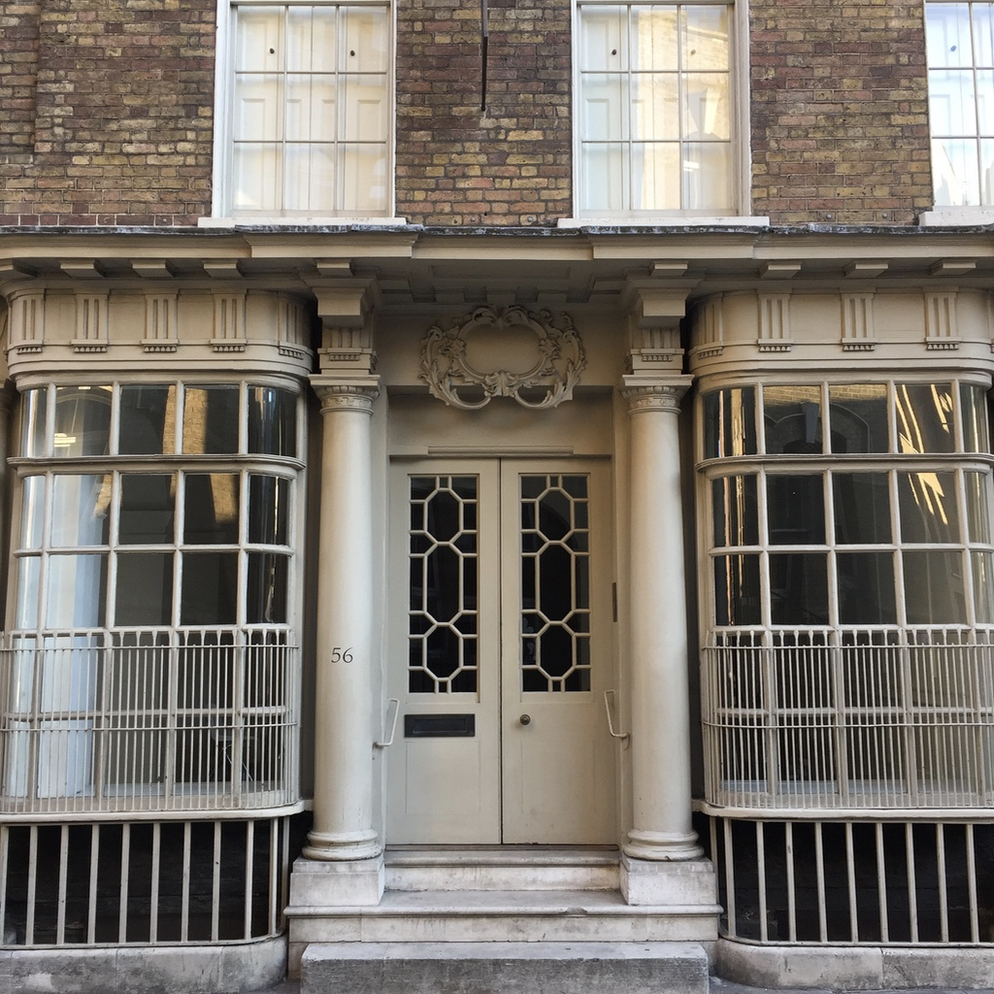
Example Projects (4): Thompson Harrison
  Associate for London-based leadership and organisational development consultancy, Thompson Harrison, which works with senior leaders and their teams to transform their organisation in response to a fluid context and a changing set of stakeholder expectations.
  Deliver bespoke experiences for senior leaders – including architectural walking tours and ‘thinking historically’ session.
  Opportunity to develop a range of products and experiences for the corporate market based more on methodological approaches, rather than factual knowledge.

Slide 21
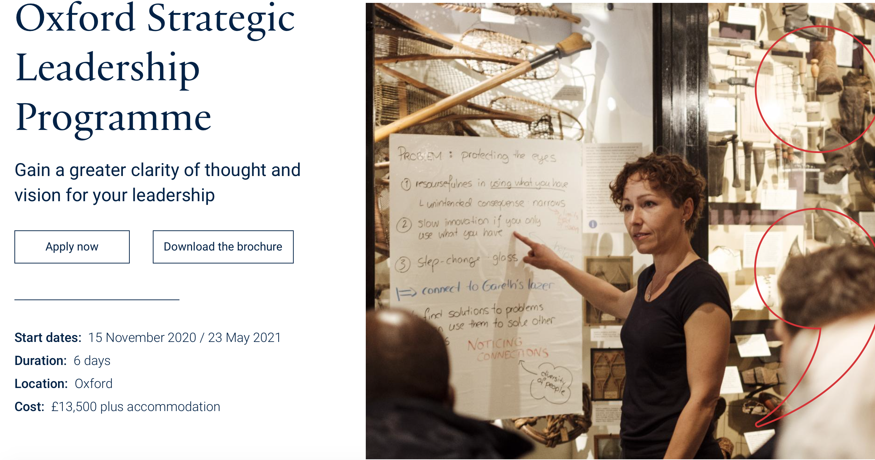
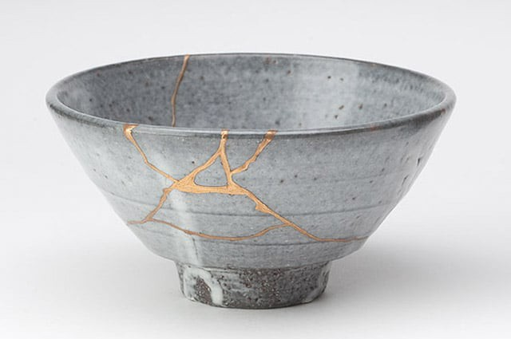
Example Projects (5): Oxford Strategic Leadership Programme
  Deliver ‘Thinking Historically’ session as part of one-week residential programme with Oxford’s Said Business School which explores the skill and craft of the historian.
  How do historians approach problem?
  How do they translate large data sets and source material into compelling stories?
  Are there aspects of the historians’ craft that can be usefully harnessed by leaders – regardless of sector or specialism?
  Kintsugi – the art of repair and the role of the historian.

Slide 22
Varieties of Entrepreneurship in SSH
Period/Site Specific Expertise
Methodological Insights
How?
Speaking the client’s language
What?

Slide 23
Why do I do it?
  Money: Consultancy offers the opportunity to make a meaningful top-up to a base salary.
  Reputation: Builds advocates for me and my work in a variety of different sectors.
  Networks: Develops my professional networks, meaning that I have a well-developed sense of what matters and why to a range of potential partners.
  Skills Development: Develops my ability to articulate what it is I do as a historian and why it matters.
  Different not Discount: Consolidates my position as someone that offers something unexpected, especially from an institution as traditional as Oxford.
  Purpose: I’m convinced that it is only by building counter-intuitive advocates for museums and heritage sites that we can secure their survival.

Slide 24
Workshop 1: Mapping the Barriers to Consultancy and Finding the Opportunities .

Slide 25
Group 1: What are the barriers to consultancy in SSH?
Individual Academics ? ? ? ? ? ? ? ? ? | Universities ? ? ? ? ? ? ? ? ? | External Partners/Clients for Consultancy ? ? ? ? ? ? ? ? ?

Slide 26
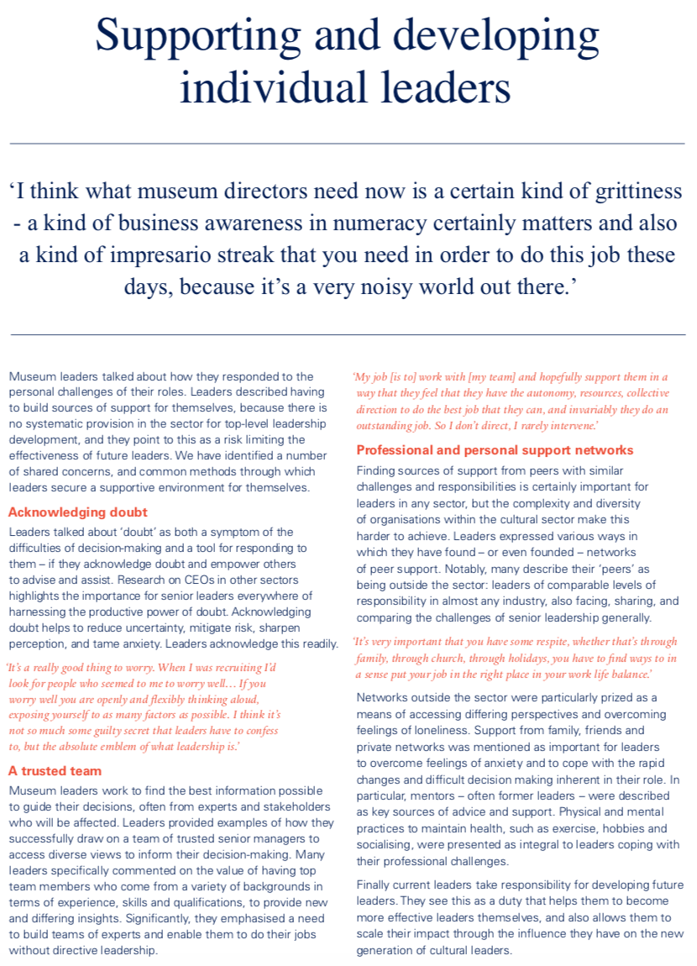
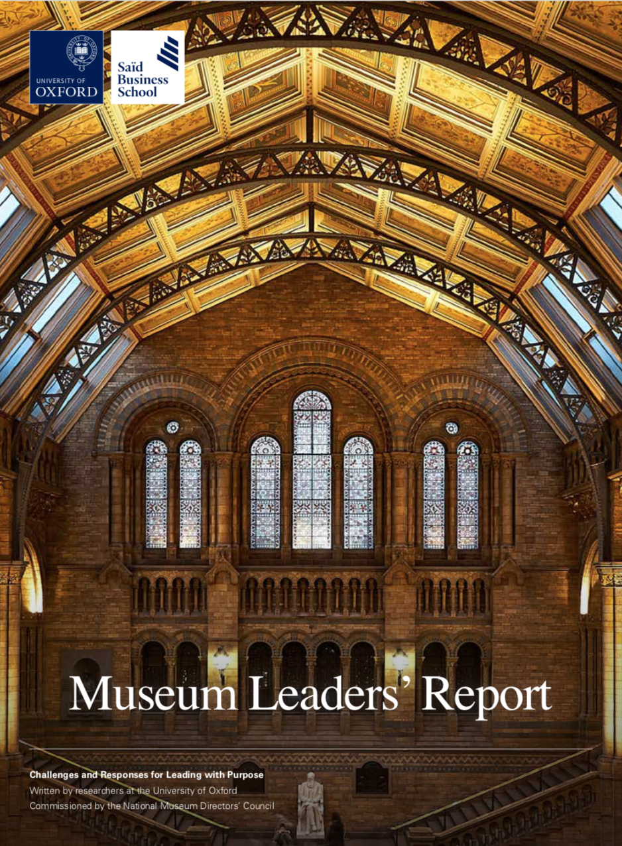
Creating an Entrepreneurial Mindset:
Finding Clues from an Adjacent
Sector.

Slide 27
Reflecting on the Session – Actions to Take Away
Hacker – ideas and processes that can be adapted and used, processes that can be re-engineered for your practice.
Thief – what, if anything, will you steal with pride from this session – stories, methods, language insights?

Slide 28
Any Questions…?

